Slide 1
Project 2 Zip Codes, Data Sources and Deadly Viruses
Group Members:
Tim Tang
Fred Tinio
Kevin Ewing
Laura De Morneau

Slide 2
Extract Process
Read data
We used several data sources to processes to cleanse and prep files in the following formats:
CSV files / JSON files / Spreadsheets
Data Sources
www.geonames.org (.txt converted to csv) and (JSON to csv)
www.cdc.gov.gov/zika/reporting/index.html (.xls converted to csv)
www.census.gov/topics/health/birth-defects (csv file)

Slide 3
Transformation Process
Data cleaning
Manipulated data and used (states as primary id)
Joining
Joined multiple data sources into one repository

Slide 4
Transformation Process Continued
Filtering
The filtering process consisted of
Aggregating
The aggregating process consisted of

Slide 5
Transformation Process Continued
Selection
The selection process consisted of
Summarization
The summarization process consisted of

Slide 6
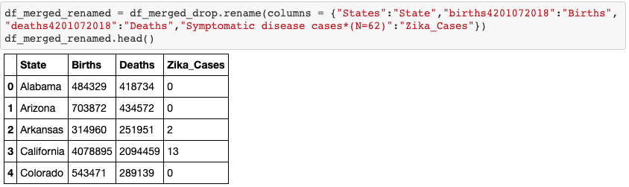
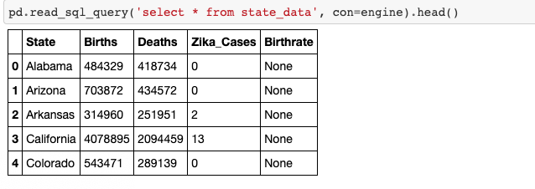

Slide 7
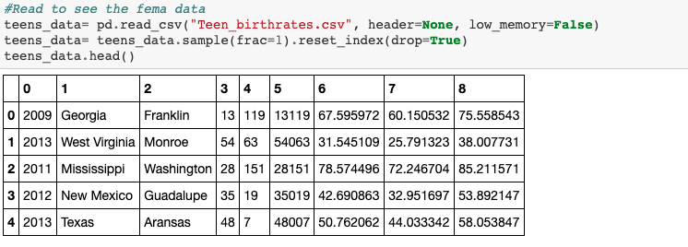
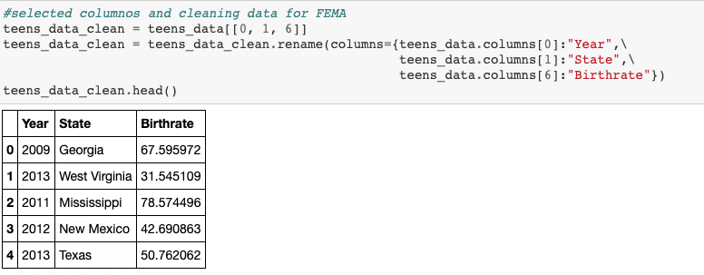

Slide 8
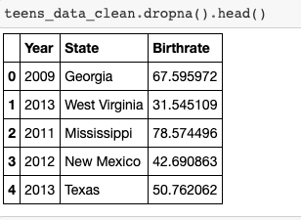
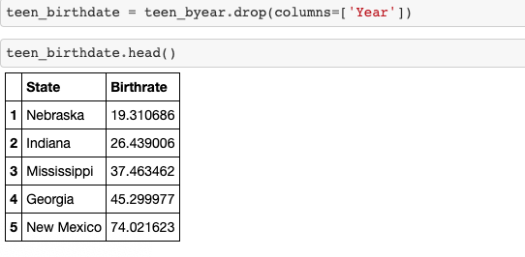

Slide 9
Load Process
Load process
The final load process consolidated multiple data sources into one central database
This database will be accessed by power users such as analysts, data scientists and executives to run various reports via multiple data management tools

Slide 10




Project 2 – ETL Process Flowchart
Extra Credit
Data
Transformation
Data Extract
Data Load
Presentation &
Visualization Layer
External Sources
Insights and
Management Tools
SAS
IBM Cognos
External & Legacy Information Sources
www.geonames.org
Pandas
Jupyter Notebook
MySQL
Brand
Touch Point
Daily
Automated
Reports
Touch Point Person
www.cdc.gov/zika
Database 1
Automation / Reporting
Field Marketer
Consumer
Analysts,
Data Scientists,
Executives
www.census.gov
Response Data
Device Data
Common End to End Audit and Validations

Slide 11
Conclusion
This entire ETL process was done to simplify day to day activities into one central repository for Data Scientists and Analysts to query data in one central location.
Each E-T-L step was tested and validated to ensure data integrity and accuracy.
Data extraction and updates is scheduled daily at 11:59pm EST
Automated daily dashboard reports generated at 7am EST
Data Scientists analysis and queries
Automated Dashboard Reporting
Other Analysis

Slide 12
Appendix

Slide 15
Daily Reporting Dashboard Snapshot
STATE | 2015 Zika Cases
California | 13
Puerto Rico | 10
Texas | 8
Florida | 6
Virginia | 5
District of Columbia | 4
Hawaii | 4
Massachusetts | 3
New York | 3
Arkansas | 2
Kentucky | 2
Maryland | 2
Minnesota | 2
Georgia | 1
Indiana | 1
Missouri | 1
New Hampshire | 1
New Jersey | 1
Pennsylvania | 1
Rhode Island | 1
Utah | 1

